Slide 1
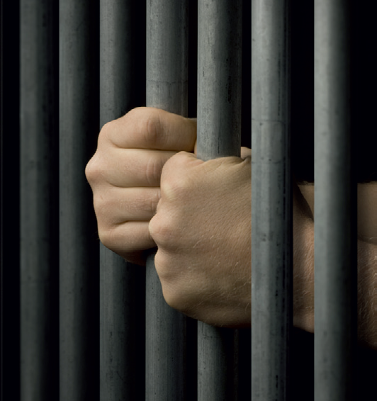
YOUTH CRIME
Year 9 Drama
Lesson 1 - A Case Of Murder

Slide 2
Lesson Objectives:
Students will explore the theme of childhood in connection with the stimuli
Students will use their knowledge of the strategies (still image and thought-tracking) to explore the theme
Students will explore why a young boy might be violent.
Notes:
This scheme of work consists of a series of six lessons based on the exploration of youth crime. It is
hoped that through practical exploration, students will gain a greater understanding of youth crime,
the types of crimes that young people commit, and most importantly why.
By the end of this scheme students will understand more about the law and young offenders, and
the reasons behind young offenders committing crimes. Throughout these lessons students will be
developing drama skills such as scriptwriting and forum theatre. The terminology and skills used
are in line with the Edexcel GCSE specification.

Slide 3
Lesson Outcomes:
I will stay in role during tasks/activities/performances.
I will perform a character different to myself during tasks/activities/performances.
I will confidently use drama techniques (thought tracking/still image) during my exploration.
I will use P.E.E.E.E.E. when evaluating my own work and the work of my peers.

Slide 4
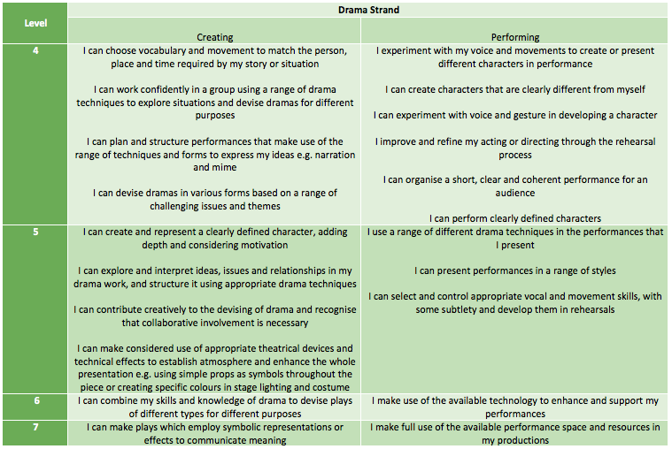
LESSON OUTCOMES

Slide 5
Warm-up
10 Minutes
Notes:
Starter example:
Please feel free to cater your warm-up activity/game to the group as you see fit.
Example warm-up:
Rubber chicken – stand students in a circle and starting with the left hand, asked students to hold their left arm above their head. Starting from 10 count backwards shaking the arm above their head on each number. Repeat with the right arm, left leg and right leg. Then repeat counting down from 9, 8, 7 etc… Once you have reached the end of 1 shout rubber chicken and students are to sake their whole body out.

Slide 6
Re-capping Key skills
What is a still image?
Working in groups of approx. 5 you will have just 1 minute to create what you think a still image is. Your still image will need to be based on the theme of ‘Bullying’. A few groups will be asked to show their work so you will need to be prepared to show your work to the rest of the class.
What is thought tracking?
Working in the same groups you have 3 minutes to add three ‘Thought Tracks’ to your ‘Still Image’ based on ‘Bullying’. Once again you will need to be prepared to show these.
What is mean by Proxemics?
You have one minute to discuss in your groups before being asked to share your ideas with the rets of the class.
7 Minutes

Slide 7
THE POEM
They should not have left him there alone, Alone that is except for the cat. He was only nine, not old enough To be left alone in a basement flat, Alone, that is, except for the cat. A dog would have been a different thing, A big gruff dog with slashing jaws, But a cat with round eyes mad as gold, Plump as a cushion with tucked-in paws--- Better have left him with a fair-sized rat! But what they did was leave him with a cat. He hated that cat; he watched it sit, A buzzing machine of soft black stuff, He sat and watched and he hated it, Snug in its fur, hot blood in a muff, And its mad gold stare and the way it sat Crooning dark warmth: he loathed all that. So he took Daddy's stick and he hit the cat. Then quick as a sudden crack in glass It hissed, black flash, to a hiding place In the dust and dark beneath the couch, And he followed the grin on his new-made face, A wide-eyed, frightened snarl of a grin, And he took the stick and he thrust it in, Hard and quick in the furry dark.
The black fur squealed and he felt his skin Prickle with sparks of dry delight. Then the cat again came into sight, Shot for the door that wasn't quite shut, But the boy, quick too, slammed fast the door: The cat, half-through, was cracked like a nut And the soft black thud was dumped on the floor. Then the boy was suddenly terrified And he bit his knuckles and cried and cried; But he had to do something with the dead thing there. His eyes squeezed beads of salty prayer But the wound of fear gaped wide and raw; He dared not touch the thing with his hands So he fetched a spade and shovelled it And dumped the load of heavy fur In the spidery cupboard under the stair Where it's been for years, and though it died It's grown in that cupboard and its hot low purr Grows slowly louder year by year: There'll not be a corner for the boy to hide When the cupboard swells and all sides split And the huge black cat pads out of it.
Notes:
The teacher should give a dramatic reading of the poem ‘A Case of Murder’ by Vernon
Scannell, reinforcing the violence by using a walking stick and red cloth.

Slide 8
4 CIRCLES
Students are placed into 4 groups.
Each group stands in a circle around one of the four questions placed on the floor.
Students are given 2 minute seconds to discuss the question and log ideas on the group answer sheet.
The 4 groups move on a carousel until they have read each question.
Notes:
Students are split into four groups, and the following questions are placed around the circle
for them to answer: What happens in the poem? What are your first impressions of the boy in the poem? Why do you think he was so violent?
What object is used and what significance might it have?

Slide 9
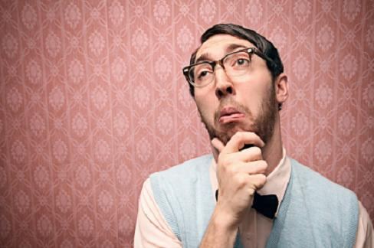
CHILDHOOD
“When the boy gets older, he does something that makes a lot of people want to know what happened in his childhood.”
Theme: Childhood.
Notes:
Teacher then explains that when the boy gets older, he does something that makes a lot of
people want to know what happened in his childhood.
Introduces the theme: Childhood.

Slide 10

WHOLE CLASS DISCUSSION
What do you think childhood should be like?
Notes:
Whole class discussion
What do you think childhood should be like?
Brainstorm on the board.

Slide 11
MAIN TASK
15-35 Minutes

Slide 12
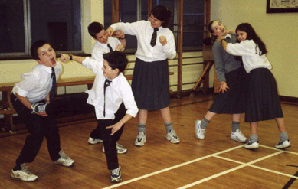
TASK – STILL IMAGE
In your groups (4 - 5), create a still image of what you think childhood should be like.
Think about the use of proxemics.

Slide 13
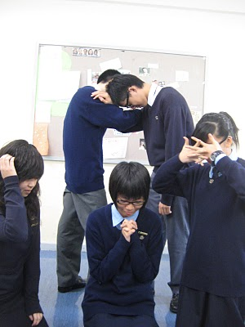
PERFORM
As a class we will look at 2 or 3 still images and give feedback where appropriate.

Slide 14
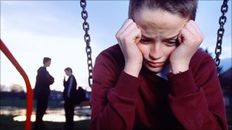
DEVELOPING THE TASK
Now, create a depiction of what sort of childhood you think the boy in the poem is having.

Slide 15
TASK – THOUGHT TRACKING
All groups now have two still images.
Develop by adding in thought-tracking to both still images and rehearse while considering their use of space and levels (proxemics.)

Slide 16
PEER FEEDBACK
35 -50 Minutes

Slide 17
PERFORM
Some groups will perform
Students are to give peer feedback using P.E.E.E.E.E
REMEMBER
Point (E)
Example (D)
Explain (C)
Explore (C/B)
Expand (B/A)
Evaluate (A)
Notes:
Choose students with a mixture of abilities to perform and use sentence starters and key
words (still image, thought-tracking, proxemics) to help them structure their feedback. Aim to
see three or four groups perform.
Evaluate the narrative behind the depictions, questioning, what kind of childhood we think
this boy had.

Slide 18
PLENARY
50 -60 Minutes

Slide 19
QUESTION TIME
ROUND ROBIN IN YOUR GROUPS
Question: Sum up in one word what kind of childhood you think this boy had.
THINK PAIR SHARE WITH SOMEONE YOU HAVEN’T WORKED WITH TODAY
Question: What do you think he might have done when he grew up?
Notes:
Allow students time to Think/Pair/Share before directly asking for an answer. Challenge more able students to elaborate on their answers, giving reasons for them.

Slide 20
HOW DID YOU DO TODAY?

Slide 21
LESSON OUTCOMES ADD LEVELS and DIFFERENTIATION
I will stay in role during tasks/activities/performances.
I will perform a character different to myself during tasks/activities/performances.
I will confidently use drama techniques (thought tracking/still image) during my exploration.
I will use P.E.E.E.E.E. when evaluating my own work and the work of my peers.

